Slide 1


Code 4 Good 2015
team 2 – Ohio Dominican University

Slide 2
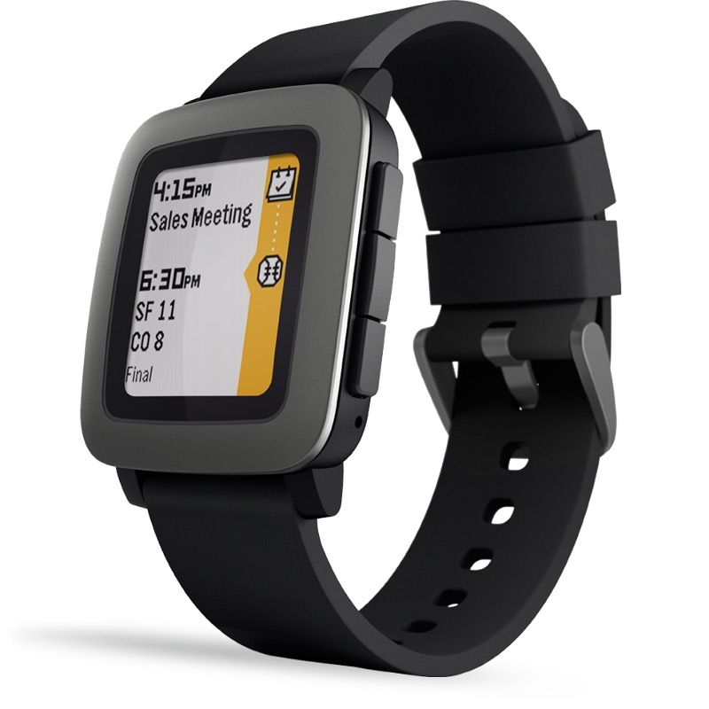
Pebble Time
Written in C
Focused Around:
Attendance
Grades
Extra Curriculars
Stressors
Utilizing:
GPS Tracking
Website integration
http://ljffwatch.weebly.com/
CultOfMac.com

Slide 3

I PROMISE
Personal
Educational
Fashionable
Simplistic
Integrated
Utilitarian
Functional
Responsive

Slide 4
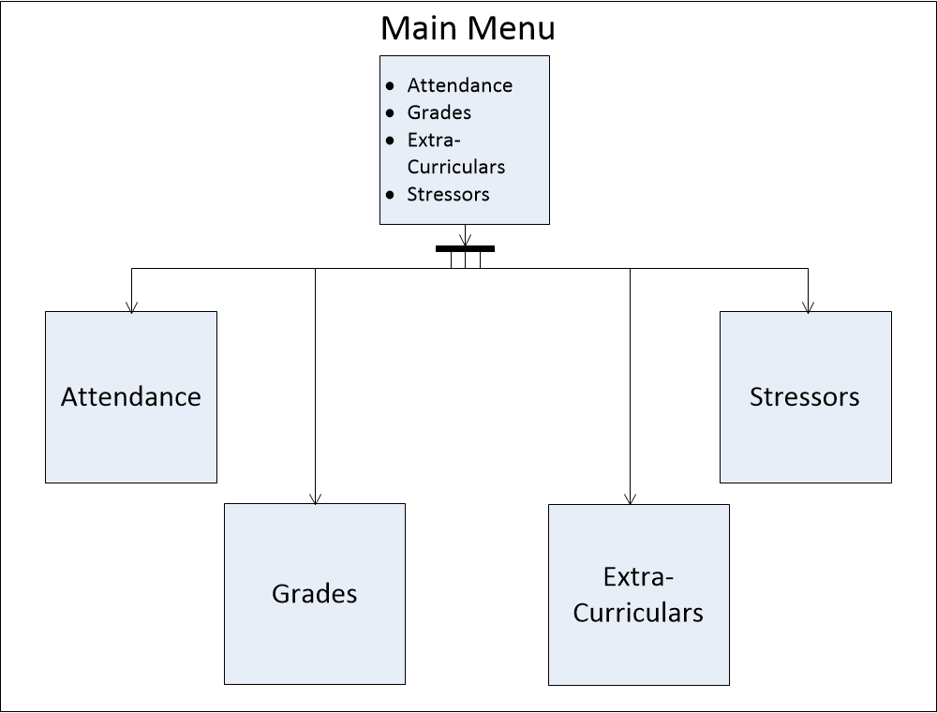

Slide 5
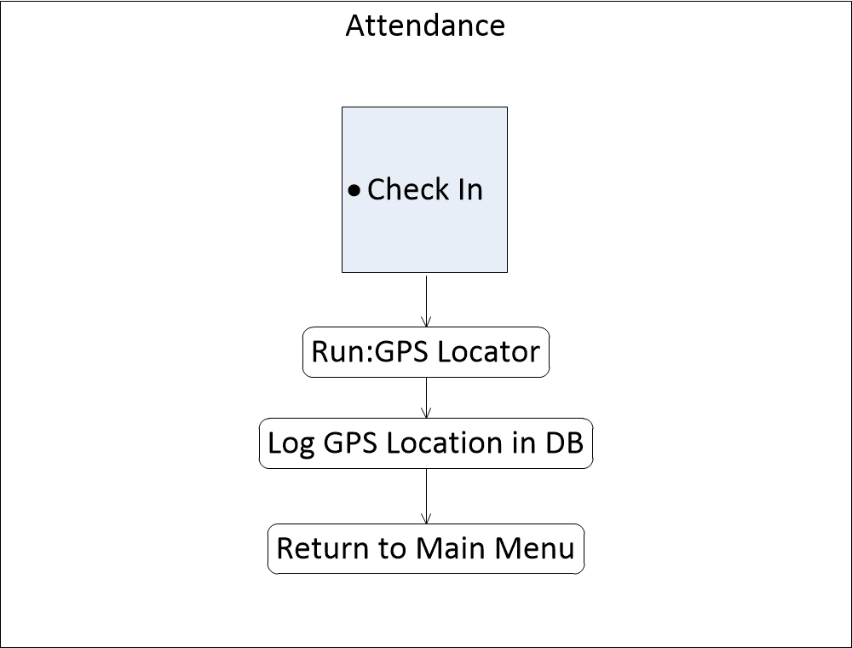

Slide 6
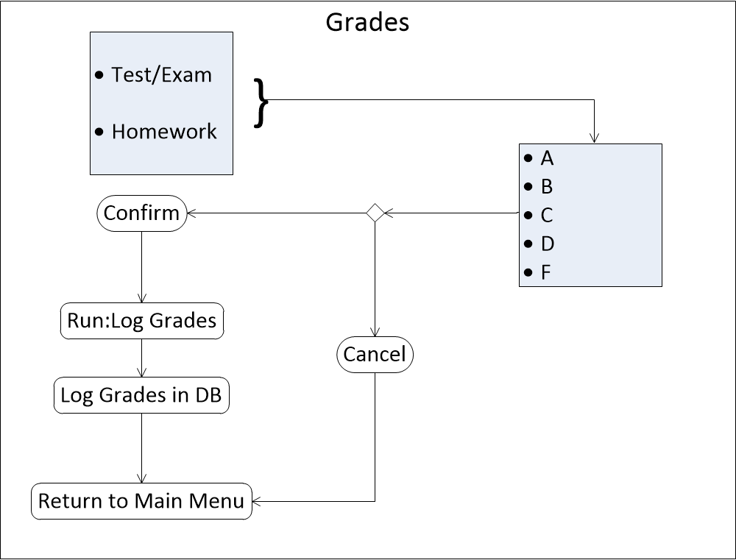

Slide 7
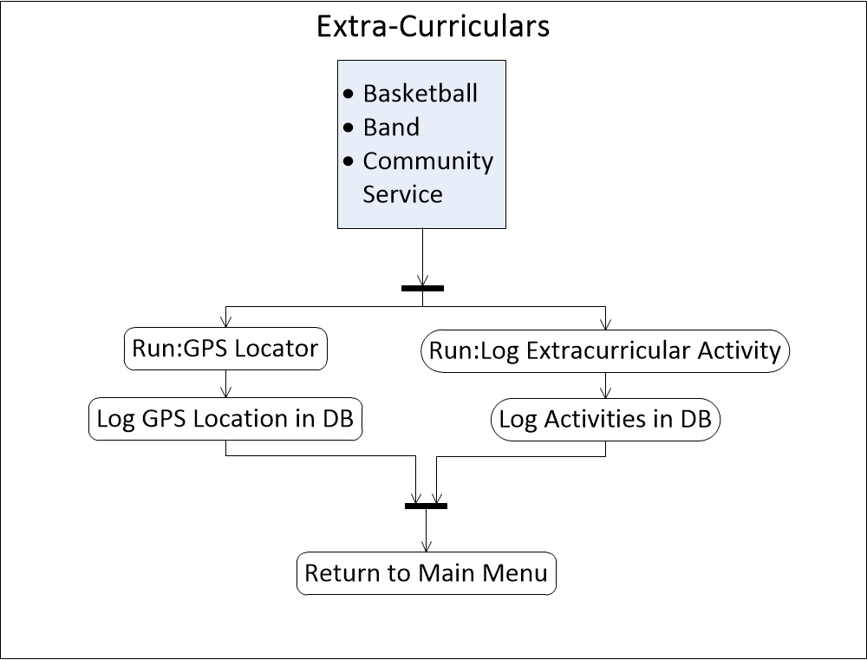

Slide 8
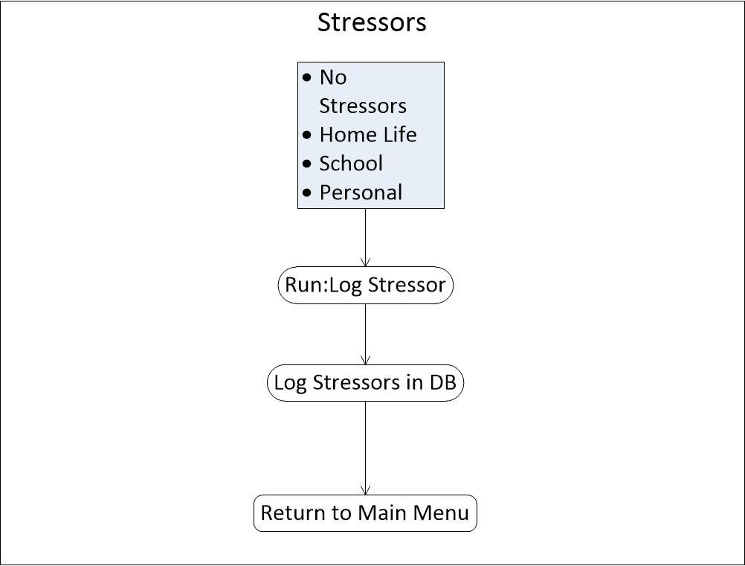

Slide 9
Potential Features
Companion App
Enter new fields for stressors or extra curriculars
Allows for communicating with the central DB
Graphing Student Statistics
Allows the student to see where they are doing well and where they can do better
Push Notifications
Stressor notifications sent to both the teachers and the foundations
Remind a student to get to class
Exercise-Tracking Software
Unified with the I PROMISE Playbook

Slide 10
Any Questions?

